Slide 1
Reinforcement Learning & Content Based Music T-REC-SYS
Group - PRO

Slide 2
What should be a good music recommendation system?
User liked songs should get repeated on regular interval.
If user has searched songs from particular era, with good probability the recommendation system should recommend songs of that era.
Let’s say user was used to listen some songs sometime ago and then he stopped listening them. Now if user searches for one of those songs, recommendation system should be able to recommend all those songs.

Slide 3
Overview..
The purpose of our Personalized Music Recommendation Engine is to use reinforcement learning approach to build a music recommender system. We formulate the problem of interactive recommendation as a contextual multi-armed bandit, learning user preferences recommending new songs and receiving their ratings. We show that using reinforcement learning solves the problem of exploitation-exploration trade-off and the cold-start problem. We integrate the novelty of songs to the model. We have embedded a content based approach to provide best recommendations.

Slide 4
Overview
The context for each arm (song) is a features vector containing the user preferences and the song features.
The reward (rating) obtained from pulling the arm (listening the
song) depends on this context. When the rating is returned,
the user preferences are updated depending on the song
features and the rating.

Slide 5
Algorithm Overview
Initially we are asking a new user to give ratings to the songs we are providing.
Then we are providing him 10 songs one by one.
After each song the listener will rate the song and accordingly the feature vector (theta) of the user will get updated.
After each iteration our feature vector (theta) is getting updated.
Now our next recommendation will be the song whose utility is maximum.

Slide 6

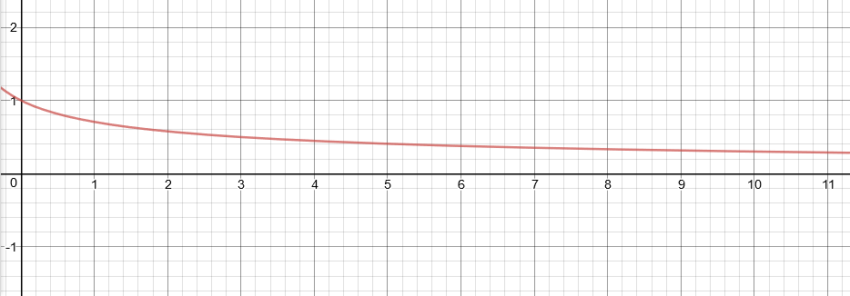
Algorithm in depth (Exploration - Exploitation)
t = t - 10
If t > 10
= 0.3
Exploration : Random unrated song
Exploitation : Song with max utility

Slide 7

Algorithm in depth (Utility)
Utility = (userFeature).(musicFeature) x (1- e^{-T/s})
T = t - last_t
last _t : Last time when the song was recommended
s: Hyper Parameter (Here, s = 50)

Slide 8
Algorithm in depth (User Feature Updation)
Initial t = 10
To reduce heavy penalty at early phase
New User Feature = (t - 1) / t * (Old User Feature) +
1 / t * (Song Feature * Song rating)

Slide 9
Dataset
We have extracted data from last.fm using its API.
Dataset contained 1000 track and year.
We divided all the 1000 songs in their respective genres
We are adding data of userid, song name and its rating in other file. It will get updated as users will give rating to new songs.

Slide 10
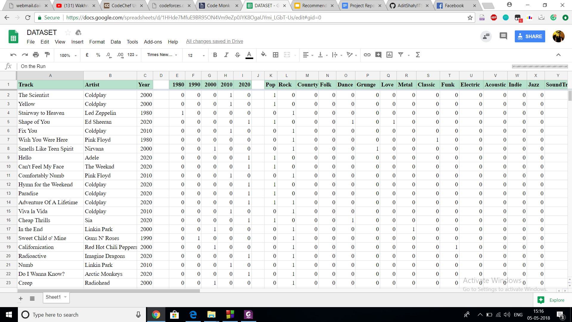
DataSet

Slide 11
Thank You

